Slide 1

Welcome

Slide 2
Business Analytics
Class - 04

Slide 3
Quick Recap
Python Basics
Pandas EDA Starting
Standardization/Normalization
Correlation/Scatter Plots/Box Plots
Treating Missing Values
Data Visualization using Seaborn

Slide 4
What we will do today
Modelling Overview
Linear Regression Introduction

Slide 5
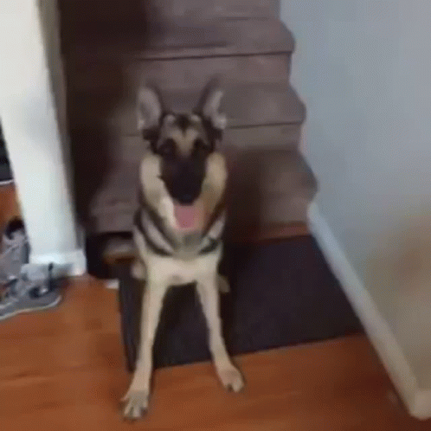
That’s it

Slide 6

Let’s go !!

Slide 7
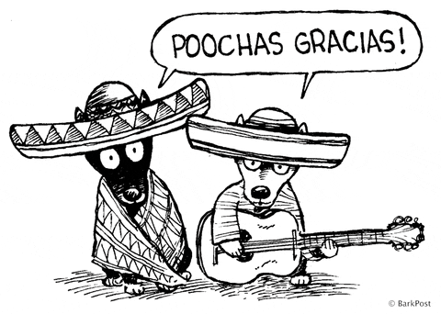
Thanks

